Slide 1

GP Contract 2025-26
Role Specific Guides – GP Partner
Starting soon...

Slide 2
GP Contract 2025-26
Role Specific Guides – GP Partner

Slide 3

GP Contract 2025-26 Partners Guide
Introduction
Notes:
Put the link to webinars page in the chat: https://www.primarycareit.co.uk/webinar-and-training-registration/

Slide 4
GP Contract 2025-26 Partners Guide
Introduction
Financial changes
QOF reform & Reducing admin
Digital and access mandates
What you need to do by when
PCN changes - ARRS and CAIP
Enhanced services and incentives
Notes:
Good news is that increased income seems to mainly be going into core funding.
Where QOF changes have happened either funding has gone into core or higher CVD targets
New CAIP - Continuity of Care funding available for high-risk patient management (via CAIP).

Slide 5
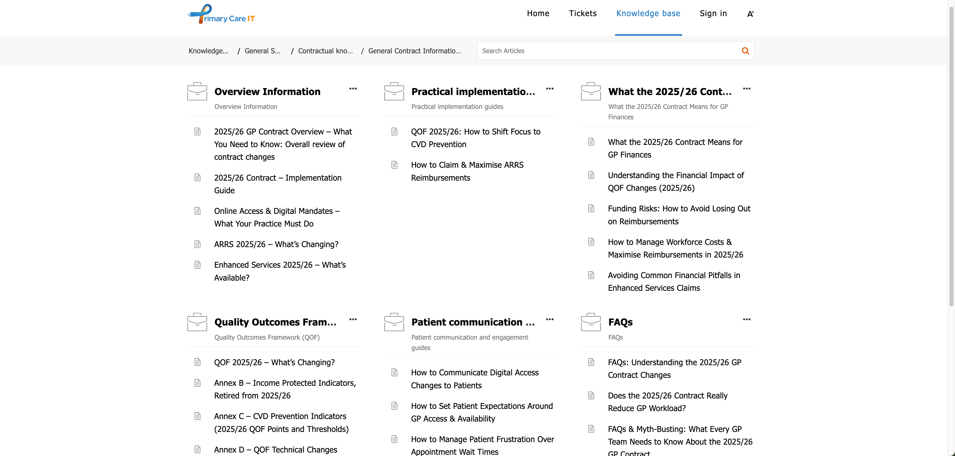
GP Contract 2025-26 Partners Guide Supporting resources
Notes:
You’ll be able to access our Knowledgebase from the Primary Care IT home page – click on the Support button at the top.
We have a section dedicated to the 25/26 contract with lots of articles. At the moment it contains just the general information and QOF, but in the coming weeks we will be publishing other articles to support the future webinars we saw on the previous slide.
Put the link to webinars page in the chat: https://www.primarycareit.co.uk/webinar-and-training-registration/

Slide 6
GP Contract 2025-26 Partners Guide
Future Webinars
Guide to New PCIT Resources
Tuesday 25th March at 12:30pm
Role Specific Guides – Practice Manager
Thursday 27th March at 12pm
Role Specific Guides – PCN Manager
Thursday 27th March at 1pm
Role Specific Guides – ICB Manager
Thursday 3rd April at 1pm
Notes:
Put the link to webinars page in the chat: https://www.primarycareit.co.uk/webinar-and-training-registration/

Slide 7
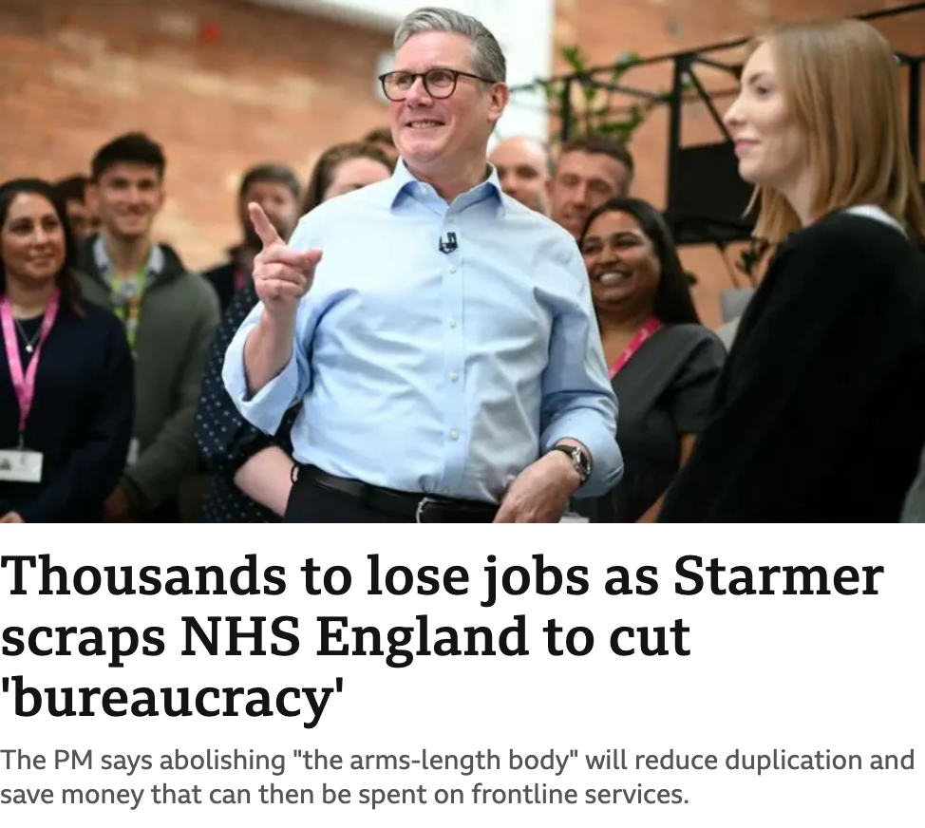


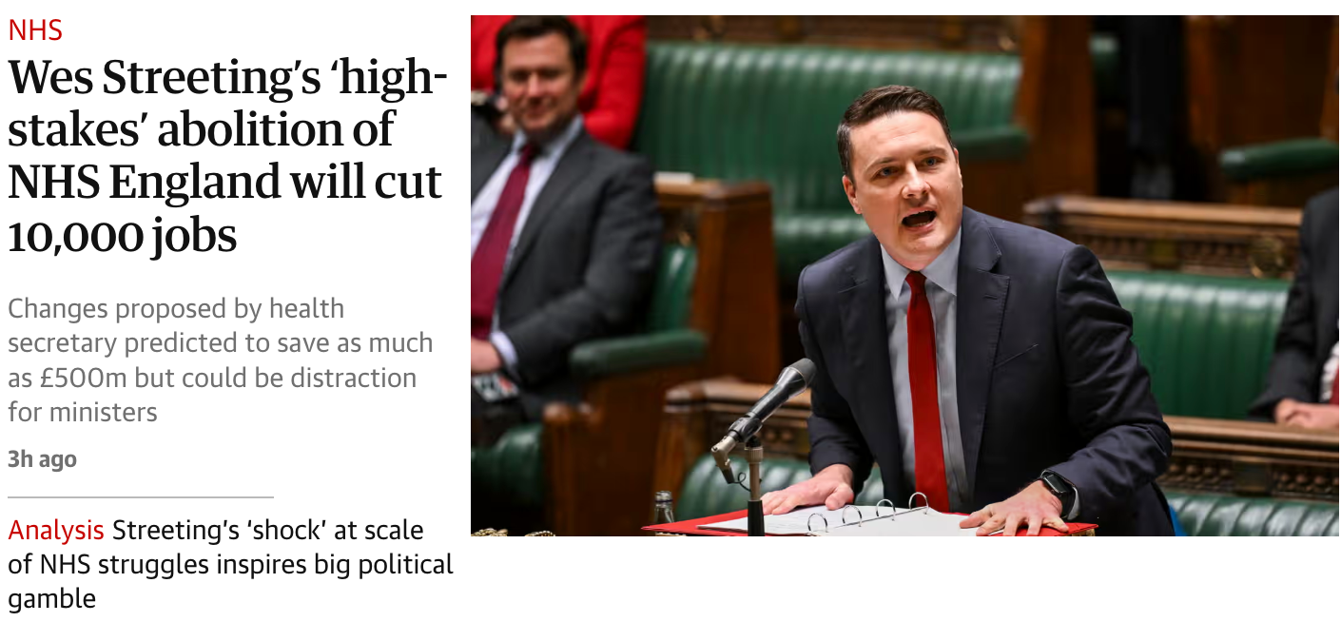
GP Contract 2025-26 Partners Guide
Introduction
Notes:
Put the link to webinars page in the chat: https://www.primarycareit.co.uk/webinar-and-training-registration/

Slide 8
GP Contract 2025-26 Partners Guide
Financial changes
Financial changes
QOF reform & Reducing admin
Digital and access mandates
PCN changes - ARRS and CAIP
Enhanced services and incentives
What you need to do by when
Notes:
Good news is that increased income seems to mainly be going into core funding.
Where QOF changes have happened either funding has gone into core or higher CVD targets
New CAIP - Continuity of Care funding available for high-risk patient management (via CAIP).

Slide 9
Financial changes
Overview
Core
A&G LES
Global sum estimated to increase to £121.90
Salaried GP ARRS reimbursement increased to £82,418
Locum reimbursement & parental leave rates increasing
£889 million additional income
£80 million additional income
Reallocation of £298mn of QOF income
Notes:
Total GP contract funding increases from £12.287bn to £13.176bn
• £889m additional core funding
• £80m for enhanced services
• Global Sum per patient estimated to rise 8.26% from £112.61 to £121.90 (this time last year the estimate was £107.57)
• Salaried GP ARRS reimbursement increased to £82,418 (+on-costs)
• Locum reimbursement & parental leave rates increasing
£20 per referral

Slide 10
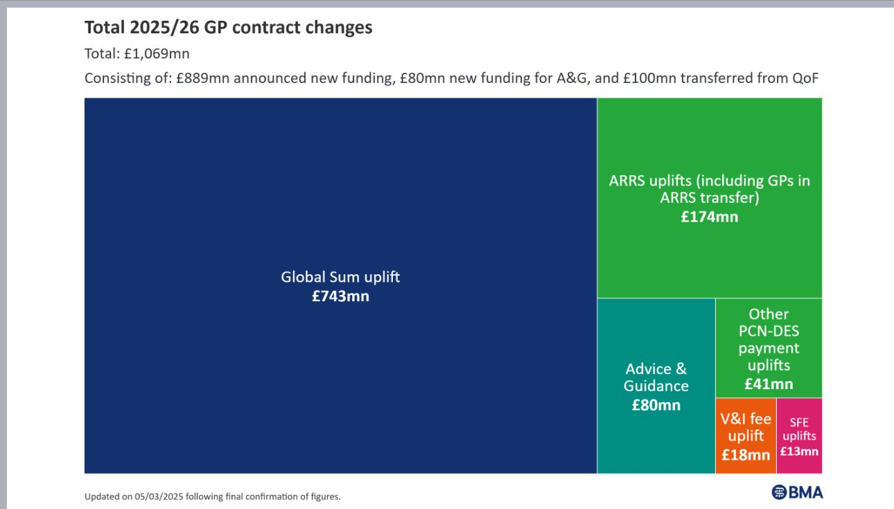
Financial changes
Increased income
Notes:
Total GP contract funding increases from £12.287bn to £13.176bn
• £889m additional core funding
• £80m for enhanced services
• Global Sum per patient estimated to rise to £121.90
• Salaried GP ARRS reimbursement increased to £82,418 (+on-costs)
• Locum reimbursement & parental leave rates increasing

Slide 11
Financial changes
Changes to be aware of
QOF funding
Global Sum
Worked out by prevalence / national prevalence
an adjustment for the age and sex structure of the population
an adjustment for the additional needs of the population - relating to morbidity and mortality
an adjustment for list turnover
a nursing and residential homes index
an adjustment for the unavoidable costs of delivering services to the population, including a market forces factor and rurality index
Risks
If you have high prevalence but a low weighted population you are likely to lose income
If you have a low or average prevalence but a high weighted population you are likely to gain income
Notes:
Total GP contract funding increases from £12.287bn to £13.176bn
• £889m additional core funding
• £80m for enhanced services
• Global Sum per patient estimated to rise to £121.90
• Salaried GP ARRS reimbursement increased to £82,418 (+on-costs)
• Locum reimbursement & parental leave rates increasing
https://support.primarycareit.co.uk/portal/en-gb/kb/articles/global-sum-income

Slide 12
GP Contract 2025-26 Partners Guide
QOF reform & Reducing admin
Financial changes
QOF reform & Reducing admin
Digital and access mandates
PCN changes - ARRS and CAIP
Enhanced services and incentives
What you need to do by when
Notes:
Good news is that increased income seems to mainly be going into core funding.
Where QOF changes have happened either funding has gone into core or higher CVD targets
New CAIP - Continuity of Care funding available for high-risk patient management (via CAIP).

Slide 13
QOF reform & Reducing admin
Retired Indicators
32 retired
QOF indicators
19 retired
Register Indicators
7 retired
Care Indicators
6 retired
QI Indicators
81 points
57 points
74 points
Notes:
Of 32 (currently protected) indicators retired: 19 are registers, 7 are for achievement, and 6 are from the QI modules.
212 points

Slide 14
QOF reform & Reducing admin
Retired Register indicators
Atrial Fibrillation
Asthma
Cancer
CHD
CKD
COPD
Dementia
Diabetes
Epilepsy
Heart Failure
Hypertension
Learning Disabilities
Obesity
Osteoporosis
Palliative Care
PAD
Rheumatoid Arthritis
Mental Health
Stroke & TIA
Notes:
This is essentially all of the QOF registers you can see. From 2024/25 this amounts to a total of 81 points. Whilst they are being “retired”, the registers are still quite important to help define the care indicator denominators, and most likely for chronic disease recalls.

Slide 15
QOF reform & Reducing admin
Retired Care Indicators
Cancer
Care Review
(6 points)
Cancer
Support Discussion
(2 points)
Depression
Review of Diagnosis
(10 points)
Asthma
Smoking Exposure in Under 19s
(6 points)
COPD
Pulmonary Rehab Referral
(2 points)
Smoking
Intervention for High-Risk Conditions
(25 points)
Mental Health
Core Health Check
(6 points)
Combined total of 57 points
Notes:
Here are the 7 care indicators that are being retired. There’s quite a spread of points between them. The question here is perhaps about clinical care – they are going from QOF but what is the clinical need to continue carrying out these activities either as specific interventions or as part of a comprehensive review? For example information about smoking and offering intervention to current smokers and offering a referral to pulmonary rehab for COPD patients.
Cancer CAN004 and CAN005 will still be important to the patient so there is a relationship with their GP.
Mental Health MH021 is a relatively short lived indicator which to some extent doubled up on the work of the other mental health indicators, and I’m sure this one won’t be missed if only for the complexity of exception reporting a patient!

Slide 16
QOF reform & Reducing admin
Retired QI Indicators
Workforce and
Wellbeing
(37 points)
Optimising use of
staff capacity
(22 points)
Reducing avoidable appointments
(15 points)
Indicator areas taken from 2023/24
Combined total of 74 points
Notes:
These 3 themes originated from the 2023/24 contract year, and for 2024/25 were rolled together into a single “Workforce and Wellbeing” theme.

Slide 17
QOF reform & Reducing admin
CHOL - Same Thresholds - More Points
Cholesterol CHOL003
Points value
14 → 38
points
Prescribed
lipid lowering drug
Notes:
We have already covered the technical changes for CHOL003 which may make little real world impact to achievement even for 2024/25. The points value here has increased considerably.
The boundaries for points achievement remain at 70% for the lower threshold and 95% for the upper threshold.
First, remember that the indicator tests for an issue of a lipid lowering drug in the last 6 months, so reporting searches will be returning 0 until October. If you have How Am I Driving searches that usually look at the last 12 months these could show the real figure.
In the context of CHOL003 and CHOL004, it would make sense to tackle the patients who are not on lipid lowering therapy sooner rather than later. Once patients are on medication, your workload for ensuring that CHOL003 has a good achievement should be that much lower as in the second half of the year you should only need to focus on a smaller number of newly diagnosed patients plus those who have stopped their medication.
Think about what you have had to do during the 24/25 contract year.
Identify who declined a lipid lowering drug and follow them up this year
Remember to use Lipid lowering therapy declined rather than statin declined, so you only have to add 1 code rather than 6 (actually 5 given icosapent ethyl has been dropped)

Slide 18
QOF reform & Reducing admin
CHOL - Increased Threshold - More Points
Cholesterol CHOL004
UT
35% → 50%
16 → 44
points
LDL ≤2.0 or non-HDL ≤2.6
UT = Upper Threshold
Notes:
The boundaries for points achievement have changed. The lower threshold remains at 20% while the upper threshold increases from 35% to 50%.

Slide 19
QOF reform & Reducing admin
BP - Increased Threshold - More Points
Hypertension
HYP008
< 80
UT
77 → 85%
14 → 38
points
HYP009
≥ 80
UT
80 → 85%
5 → 14
points
STIA
STIA014
< 80
UT
73 → 90%
3 → 8
points
UT
86 → 90%
2 → 6
points
CHD
CHD015
< 80
UT
77 → 90%
12 → 33
points
CHD016
≥ 80
UT
86 → 90%
5 → 14
points
Diabetes
DM036
< 80
(without frailty)
UT
78 → 90%
10 → 27
points
STIA015
≥ 80
Notes:
The threshold changes are shown here on the screen.
For presenter info:
INDICATOR LT PTS INCREASE
HYP008 40 x2.7
HYP009 40 x2.8
STIA014 40 x2.66
STIA015 46 x3
CHD015 40 x2.75
CHD016 46 x2.8
DM036 38 x2.7
Highlight the change about DM036 now being under 80s. Leads to potential improvement / fewer PCAs needed for elderly patients who can’t be brought below target threshold.
Again, home BPs still have a lower target for all of these

Slide 20
QOF reform & Reducing admin
What does this mean for me?
If 10k patients:
0 extra patients
CHOL004
73 extra patients
worth extra £5,600
BP
7 indicators
224 extra patients
worth extra £17,800
CHOL003
worth extra £4,800
PATIENTS ON MULTIPLE INDICATORS WILL BE WORTH EVEN MORE MONEY THAN BEFORE!
NOT NEW MONEY!
Figures calculated on a list size of 10,000 with no adjustments for list size or prevalence and assuming £200 per QOF point

Slide 21
QOF reform & Reducing admin
What does this mean for me?
What if we don’t do the extra CHOL & BP work?
Total potential loss
£9,932
Figures calculated on £200 per QOF point with no list size or prevalence adjustment
Notes:
If achieve the same % as the UT for 2024/25 these are the potential amounts the practice could lose (assuming £200 per point and no list size or prevalence adjustment)
CHD015 - £1,716
CHD016 - £254.55
HYP008 – £1,351.11
HYP009 - £311.11
STIA014 - £544
STIA015 - £109.09
DM036 - £1,246.15
CHOL003 – 0 (UT remains the same)
CHOL004 - £4,400

Slide 22
QOF reform & Reducing admin
Other QOF Changes
Cholesterol medication updated in cholesterol and diabetes KPIs
Diabetes BP now for <80 only
No spirometry needed for asthma diagnosis
Asthma review – no longer need ACT or inhaler technique
PCA added for DOAC in AF (AF008)
Notes:
Big thing missing is concessions to childhood vaccinations targets
Indicators that were previously known as DM022/023 now accommodate alternative lipid lowering therapies that we know from CHOL003.
Concede that inhaler technique has never been a measurable requirement, despite being in the indicator description.
AF008 – invitation PCA

Slide 23
QOF reform & Reducing admin
“Reduced admin”
No more reporting on
staff wellbeing meetings
IT system reviews
other non-clinical metrics

Slide 24
GP Contract 2025-26 Partners Guide
Digital and access mandates
Financial changes
QOF reform & Reducing admin
Digital and access mandates
PCN changes - ARRS and CAIP
Enhanced services and incentives
What you need to do by when
Notes:
Good news is that increased income seems to mainly be going into core funding.
Where QOF changes have happened either funding has gone into core or higher CVD targets
New CAIP - Continuity of Care funding available for high-risk patient management (via CAIP).

Slide 25
Digital and access mandates
Requirements
Online GP appointment requests must be available during core hours from October 2025
GP Connect must be enabled to allow patient record sharing with NHS providers & private healthcare (with consent)
Community Pharmacy consultation summaries will be automatically sent into GP workflows
New "Patient Charter" will outline patient expectations & must be published on all practice websites
Notes:
From October 2025, practices must offer an online system where patients can:
Request an appointment during core hours.
Request administrative or medication queries.
Receive digital responses when appropriate.
Online access must not replace traditional telephone and in-person booking but should work alongside them to reduce patient frustration.

Slide 26
GP Contract 2025-26 Partners Guide
PCN changes – ARRS and CAIP
Financial changes
QOF reform & Reducing admin
Digital and access mandates
PCN changes - ARRS and CAIP
Enhanced services and incentives
What you need to do by when
Notes:
Good news is that increased income seems to mainly be going into core funding.
Where QOF changes have happened either funding has gone into core or higher CVD targets
New CAIP - Continuity of Care funding available for high-risk patient management (via CAIP).

Slide 27
PCN changes – ARRS and CAIP
Flexibility with Workforce and ARRS
ARRS expanded to include GPs and practice nurses, with no recruitment caps
Salary reimbursement for ARRS-funded GPs increased to £82,418
Greater PCN autonomy in distributing workforce funding

Slide 28
PCN changes – ARRS and CAIP
New Capacity and Access Improvement Plan
£87.6mn PCN Capacity & Access Improvement Payment (CAIP) split into:
£58.4mn for modern general practice access
£29.2mn for population health risk stratification to improve continuity of care

Slide 29
GP Contract 2025-26 Partners Guide
Enhanced services and incentives
Financial changes
QOF reform & Reducing admin
Digital and access mandates
ARRS changes
Enhanced services and incentives
What you need to do by when
Notes:
Good news is that increased income seems to mainly be going into core funding.
Where QOF changes have happened either funding has gone into core or higher CVD targets
New CAIP - Continuity of Care funding available for high-risk patient management (via CAIP).

Slide 30
Enhanced services and incentives
Advice and Guidance LES
£80m for A&G
£20 per referral
£80mn guaranteed for Primary Care
Local commissioners can decide on action once funding used
Notes:
About £1.25 per patient for funding

Slide 31
Enhanced services and incentives
Weight Management LES
£11.50 per referral to Weight Management Services
Notes:
About £1.25 per patient for funding

Slide 32
GP Contract 2025-26 Partners Guide
What you need to do by when
Financial changes
QOF reform & Reducing admin
Digital and access mandates
ARRS changes
Enhanced services and incentives
What you need to do by when
Notes:
Good news is that increased income seems to mainly be going into core funding.
Where QOF changes have happened either funding has gone into core or higher CVD targets
New CAIP - Continuity of Care funding available for high-risk patient management (via CAIP).

Slide 33
What you need to do by when
Key Deadlines & Compliance Requirements
April 2025
October 2025
New GP contract changes come into effect
Online GP appointment requests must be available during core hours
Practices must align with new QOF and Enhanced Services requirements

Slide 34
What you need to do by when
Detailed planning required by practices/PCNs
April 2025
Practices should begin digital transition planning – deciding model and plans
Update practice materials and train staff on explaining continuity of care
Review and update practice communications on wait times
Identify training needs and schedule initial sessions for staff re online/digital
Review of ARRS roles and strategic planning
August/September 2025
September 2025
Display posters and train staff
Inform patients about practice plans for continuity of care via website, SMS, posters, and social media
Start SMS and social media campaigns
October 2025
Practices should have ARRS workforce expansion plans in place
Online appointment access and GP Connect must be fully implemented
March 2026
Ensure full utilisation of ARRS funding before year-end

Slide 35

Questions?

