Slide 1

Starting soon...
Overview of Contract Changes for 2025 26

Slide 2
Overview of Contract Changes for 2025 26

Slide 3

Introduction
Notes:
Put the link to webinars page in the chat: https://www.primarycareit.co.uk/webinar-and-training-registration/

Slide 4
Changes
Increased income
Increased / Decreased work
New flexibility with Workforce & ARRS
What you need to do by when
Notes:
Good news is that increased income seems to mainly be going into core funding.
Where QOF changes have happened either funding has gone into core or higher CVD targets
New CAIP - Continuity of Care funding available for high-risk patient management (via CAIP).

Slide 5
Future Webinars
Wednesday 19th March at 12pm
Guide to New PCIT Resources
QOF Changes and Planning for 2025/26
Tuesday 25th March at 12pm
Role Specific Guides – GP Partner
Tuesday 25th March at 12:30pm
Role Specific Guides – Practice Manager
Thursday 27th March at 12pm
Role Specific Guides – PCN Manager
Thursday 27th March at 1pm
Role Specific Guides – ICB Manager
Thursday 3rd April at 1pm
Notes:
Put the link to webinars page in the chat: https://www.primarycareit.co.uk/webinar-and-training-registration/

Slide 6
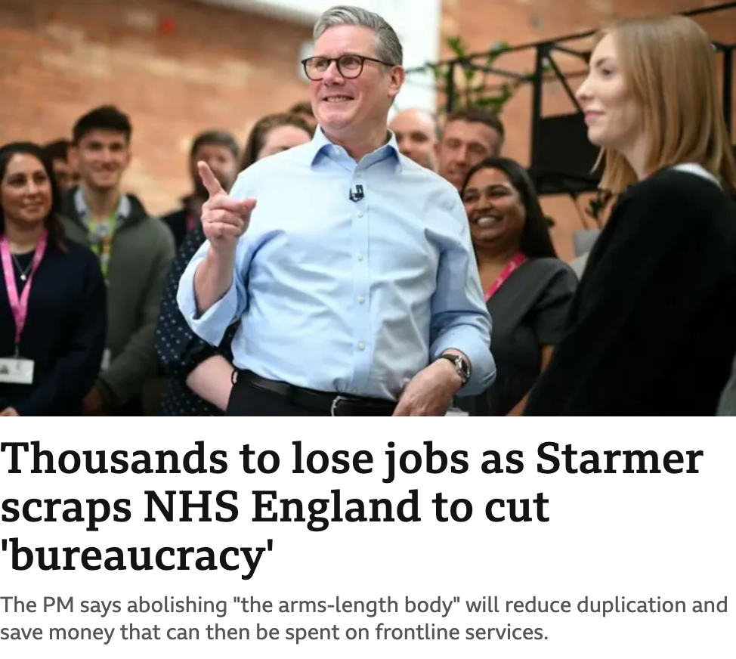


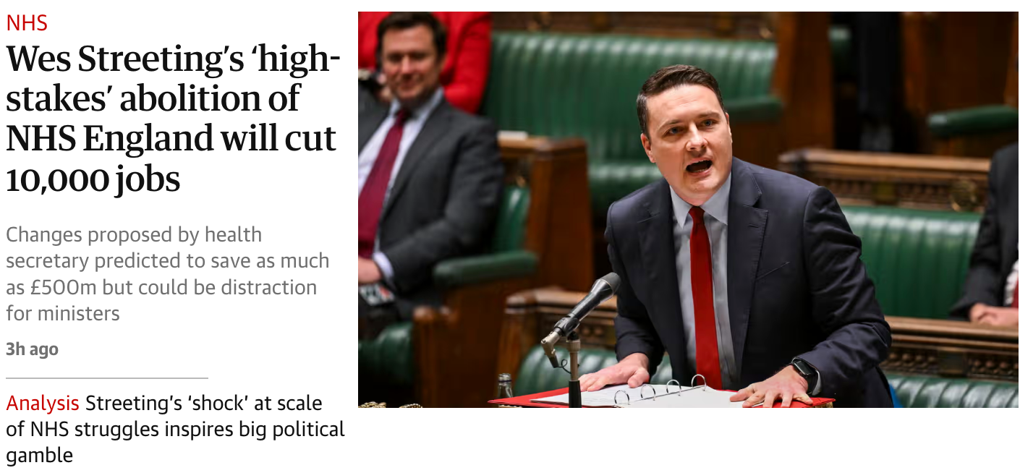
Introduction
Notes:
Put the link to webinars page in the chat: https://www.primarycareit.co.uk/webinar-and-training-registration/

Slide 7
Changes
Increased income
Increased income
Increased / Decreased work
New flexibility with Workforce & ARRS
What you need to do by when
Notes:
Good news is that increased income seems to mainly be going into core funding.
Where QOF changes have happened either funding has gone into core or higher CVD targets
New CAIP - Continuity of Care funding available for high-risk patient management (via CAIP).

Slide 8
Increased income
Core
A&G LES
Global sum estimated to increase to £121.90
Salaried GP ARRS reimbursement increased to £82,418
Locum reimbursement & parental leave rates increasing
£889 million additional income
£80 million additional income
Notes:
Total GP contract funding increases from £12.287bn to £13.176bn
• £889m additional core funding
• £80m for enhanced services
• Global Sum per patient estimated to rise 8.26% from £112.61 to £121.90 (this time last year the estimate was £107.57)
• Salaried GP ARRS reimbursement increased to £82,418 (+on-costs)
• Locum reimbursement & parental leave rates increasing

Slide 9
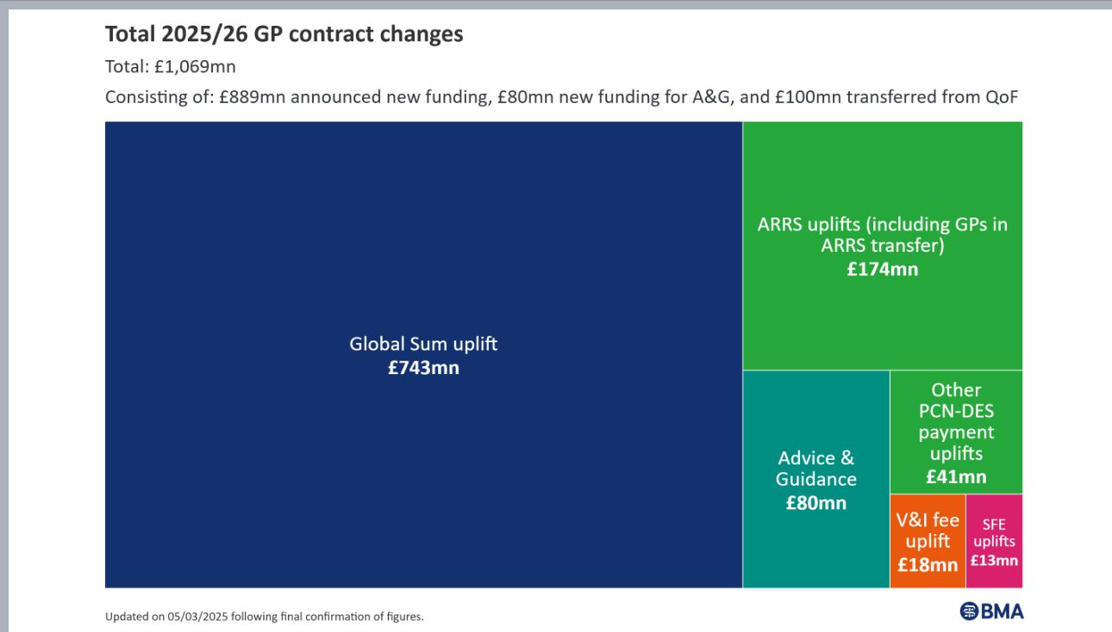
Increased income
Notes:
Total GP contract funding increases from £12.287bn to £13.176bn
• £889m additional core funding
• £80m for enhanced services
• Global Sum per patient estimated to rise to £121.90
• Salaried GP ARRS reimbursement increased to £82,418 (+on-costs)
• Locum reimbursement & parental leave rates increasing

Slide 10
Changes
Increased / Decreased work
Increased income
Increased / Decreased work
New flexibility with Workforce & ARRS
What you need to do by when
Notes:
Good news is that increased income seems to mainly be going into core funding.
Where QOF changes have happened either funding has gone into core or higher CVD targets
New CAIP - Continuity of Care funding available for high-risk patient management (via CAIP).

Slide 11
Increased / decreased workload
QOF Changes
"Reduced admin"
Digital and Access Requirements
Capacity and Access Improvement Plan
Childhood Immunisations
Advice and Guidance LES
Increased / decreased workload
Notes:
About £1.25 per patient for funding

Slide 12
Advice and Guidance LES
£80m for A&G
£20 per referral
£80mn guaranteed for Primary Care
Local commissioners can decide on action once funding used
QOF Changes
"Reduced admin"
Digital and Access Requirements
Capacity and Access Improvement Plan
Childhood Immunisations
Advice and Guidance LES
Notes:
About £1.25 per patient for funding

Slide 13
QOF Changes
32 QOF indicators permanently retired
212 points removed
(£298mn)
71 points (£100mn) into Global Sum & Vaccine fees
141 points (£198mn) extending QOF CV indicators
QOF Changes
"Reduced admin"
Digital and Access Requirements
Capacity and Access Improvement Plan
Childhood Immunisations
Advice and Guidance LES
Notes:
Of 32 (currently protected) indicators retired: 18 are registers, 8 are for achievement, and 6 are from the QI modules.

Slide 14
Other QOF Changes
Cholesterol medication updated in cholesterol and diabetes KPIs
Diabetes BP now for <80 only
No spirometry needed for asthma diagnosis
Asthma review – no longer need ACT or inhaler technique
PCA added for DOAC in AF (AF008)
QOF Changes
"Reduced admin"
Digital and Access Requirements
Capacity and Access Improvement Plan
Childhood Immunisations
Advice and Guidance LES
Notes:
Big thing missing is concessions to childhood vaccinations targets
Indicators that were previously known as DM022/023 now accommodate alternative lipid lowering therapies that we know from CHOL003.
Concede that inhaler technique has never been a measurable requirement, despite being in the indicator description.
AF008 – invitation PCA

Slide 15
“Reduced admin”
No more reporting on
staff wellbeing meetings
IT system reviews
other non-clinical metrics
QOF Changes
"Reduced admin"
Digital and Access Requirements
Capacity and Access Improvement Plan
Childhood Immunisations
Advice and Guidance LES

Slide 16
Digital and Access Requirements
Online GP appointment requests must be available during core hours from October 2025
GP Connect must be enabled to allow patient record sharing with NHS providers & private healthcare (with consent)
Community Pharmacy consultation summaries will be automatically sent into GP workflows
New "Patient Charter" will outline patient expectations & must be published on all practice websites
QOF Changes
"Reduced admin"
Digital and Access Requirements
Capacity and Access Improvement Plan
Childhood Immunisations
Advice and Guidance LES
Notes:
From October 2025, practices must offer an online system where patients can:
Request an appointment during core hours.
Request administrative or medication queries.
Receive digital responses when appropriate.
Online access must not replace traditional telephone and in-person booking but should work alongside them to reduce patient frustration.

Slide 17
New Capacity and Access Improvement Plan
£87.6mn PCN Capacity & Access Improvement Payment (CAIP) split into:
£58.4mn for modern general practice access
£29.2mn for population health risk stratification to improve continuity of care
QOF Changes
"Reduced admin"
Digital and Access Requirements
Capacity and Access Improvement Plan
Childhood Immunisations
Advice and Guidance LES

Slide 18
Childhood imms
1st July 2025
Cessation of Hib/MenC 12-month Dose
1st Jan 2026
MMR Programme Schedule Change and Catch-Up
Varicella (Chickenpox) Introduction and Catch-Up (subject to final policy decision)
QOF Changes
"Reduced admin"
Digital and Access Requirements
Capacity and Access Improvement Plan
Childhood Immunisations
Advice and Guidance LES

Slide 19
Changes
New flexibility with Workforce & ARRS
Increased income
Increased / Decreased work
New flexibility with Workforce & ARRS
What you need to do by when
Notes:
Good news is that increased income seems to mainly be going into core funding.
Where QOF changes have happened either funding has gone into core or higher CVD targets
New CAIP - Continuity of Care funding available for high-risk patient management (via CAIP).

Slide 20
Flexibility with Workforce and ARRS
ARRS expanded to include GPs and practice nurses, with no recruitment caps
Salary reimbursement for ARRS-funded GPs increased to £82,418
Greater PCN autonomy in distributing workforce funding

Slide 21
Changes
What you need to do by when
Increased income
Increased / Decreased work
New flexibility with Workforce & ARRS
What you need to do by when
Notes:
Good news is that increased income seems to mainly be going into core funding.
Where QOF changes have happened either funding has gone into core or higher CVD targets
New CAIP - Continuity of Care funding available for high-risk patient management (via CAIP).

Slide 22
Key Deadlines & Compliance Requirements
April 2025
October 2025
New GP contract changes come into effect
Online GP appointment requests must be available during core hours
Practices must align with new QOF and Enhanced Services requirements

Slide 23
Detailed planning required by practices/PCNs
April 2025
Practices should begin digital transition planning – deciding model and plans
Update practice materials and train staff on explaining continuity of care
Review and update practice communications on wait times
Identify training needs and schedule initial sessions for staff re online/digital
Review of ARRS roles and strategic planning
1 July 2025
August/September 2025
September 2025
Display posters and train staff
Inform patients about practice plans for continuity of care via website, SMS, posters, and social media
Start SMS and social media campaigns
Cessation of Hib/MenC dose at 12 months of age

Slide 24
Detailed planning required by practices/PCNs
October 2025
Practices should have ARRS workforce expansion plans in place
Online appointment access and GP Connect must be fully implemented
1 January 2026
March 2026
End of October 2026
31 March 2027
1 April 2027
Opportunistic varicella offer begins
Deadline for MMRV catch-up programme for children under 11
Deadline for MMR brought-forward appointments
Ensure full utilisation of ARRS funding before year-end
New 18-month immunisation visit begins

Slide 25
View from the community

Slide 26

Questions?

