Slide 1

GP Contract Changes 2025/26
Starting soon...
Role Specific Guides
Practice Manager

Slide 2
GP Contract Changes 2025-26
Role Specific Guides
Practice Manager

Slide 3

GP Contract 2025-26 Practice Manager’s Guide
Introduction
Notes:
Thank you for joining us today when we are going to be looking at the GP Contract Changes for 2025/26
I am Vanessa, the customer service lead for PCIT and I am joined by Sarah who is one of our senior developers.​
Some housekeeping for today, if you want to ask a question please put it into the chat and we answer them as we go along. ​
This is going to be recorded.
We do have only 20 minutes so we will go through these slides quite quickly but if you are interested, we could look at setting up a Q&A drop in session. Please let us know if this would like this

Slide 4
GP Contract 2025-26 Practice Manager’s Guide
Future Webinars
Guide to New PCIT Resources
Thursday 27th March at 12pm
Role Specific Guides – PCN Manager
Thursday 27th March at 1pm
Role Specific Guides – ICB Manager
Thursday 3rd April at 1pm
Notes:
And on screen you will see some of the webinars that we will be hosting over the next few weeks that will break down some of the information from the letter that came out a few weeks ago, and you are welcome to join any of them and we will put a link in the chat : https://www.primarycareit.co.uk/webinar-and-training-registration/
And next month we will be doing a webinar on the new PCIT resources that has been produced not only for these resources but the rest of QoF as well.

Slide 5
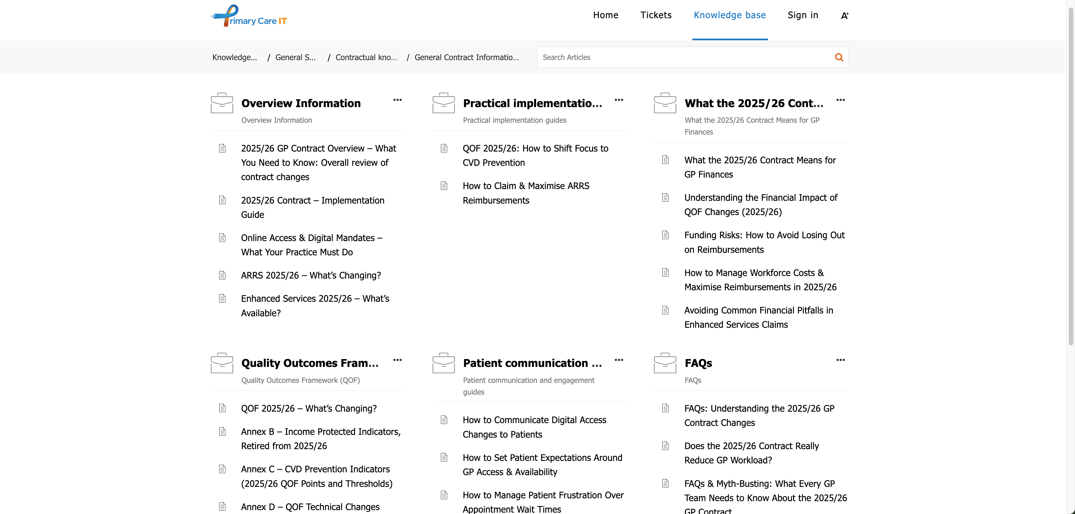
GP Contract 2025-26 Practice Manager’s Guide
Supporting Resources
Notes:
You’ll be able to access our Knowledgebase from the Primary Care IT home page – click on the Support button at the top of the page.
We have a section dedicated to the 25/26 contract with lots of articles. At the moment it contains just the general information and QOF, but in the coming weeks we will be publishing other articles to support the future webinars that we saw on the previous slide.

Slide 6
GP Contract 2025-26 Practice Manager’s Guide
Changes
Financial Changes
QOF Reform and Reducing Admin
Digital and Access Mandates
Planning Ahead
PCN Changes - ARRS and CAIP
Enhanced Services and Incentives
Notes:
Today we are going to be looking as some of the changes that may affect you

Slide 7
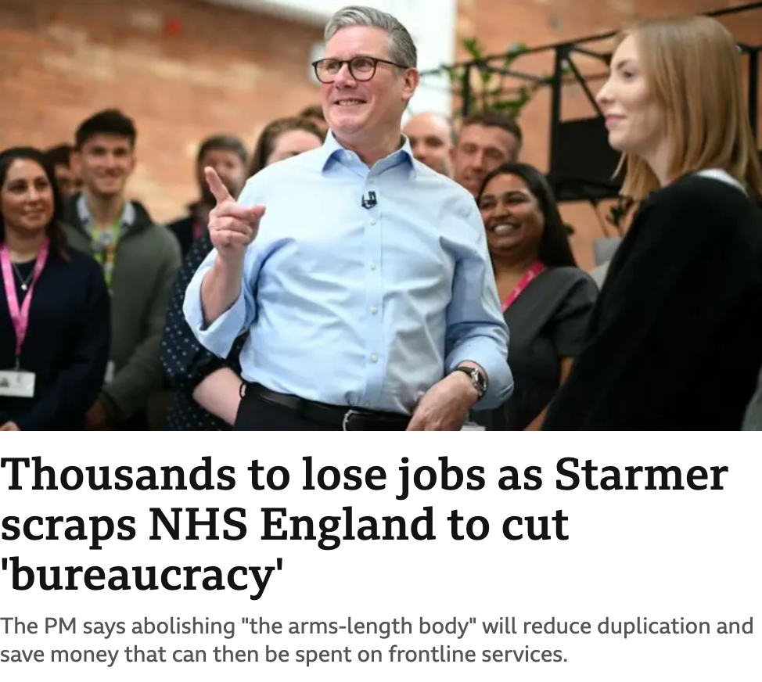


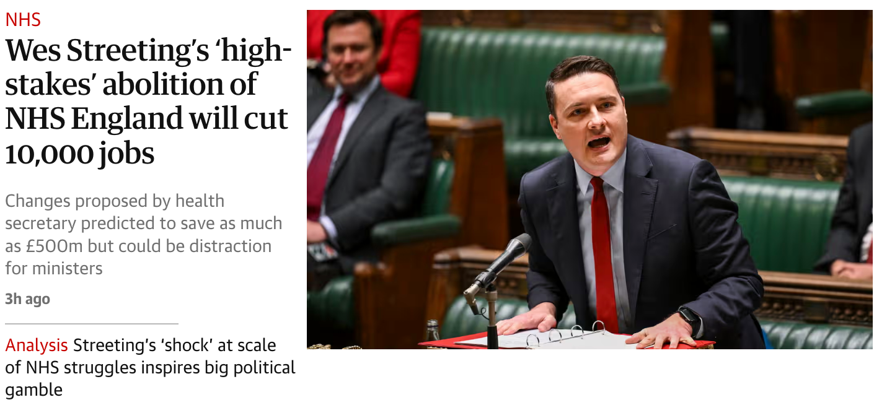
GP Contract 2025-26 Practice Manager’s Guide
Introduction
Notes:
Obviously there is now a lot of uncertainty with the news that NHS England will be abolished and we currently don’t know any more information than you do.

Slide 8
GP Contract 2025-26 Practice Manager’s Guide
Financial Changes
Financial Changes
QOF Reform and Reducing Admin
Digital and Access Mandates
PCN Changes - ARRS and CAIP
Enhanced Services and Incentives
Planning Ahead
Notes:
Lets look at the financial changes.

Slide 9
GP Contract 2025-26 Practice Manager’s Guide
Financial Changes
Core
A&G LES
Global sum estimated to increase to £121.90
Salaried GP ARRS reimbursement increased to £82,418
Locum reimbursement & parental leave rates increasing
£889 million additional income
£80 million additional income
Reallocation of £298mn of QOF income
IoS for Childhood Vaccinations Increased from £10.06 to £12.06
Notes:
Total GP contract funding increases from £12.287bn to £13.176bn
• £889m additional core funding
• £80m for enhanced services
• Global Sum per patient estimated to rise 8.26% from £112.61 to £121.90 (this time last year the estimate was £107.57)
• Salaried GP ARRS reimbursement increased to £82,418 (+on-costs)
• Locum reimbursement & parental leave rates increasing
£20 per referral

Slide 10
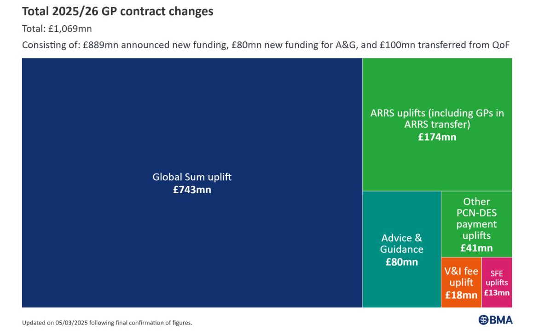
GP Contract 2025-26 Practice Manager’s Guide
Increased Income
Notes:
And you can see how this is broken down in more detail

Slide 11
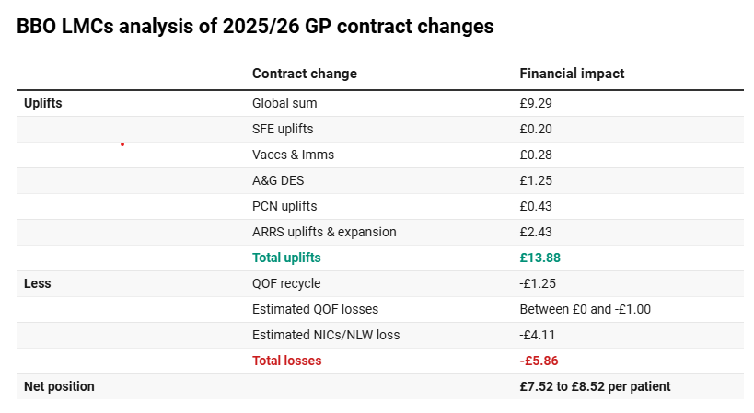
GP Contract 2025-26 Practice Manager’s Guide
Potential Net Increase?
https://www.pulsetoday.co.uk/news/2025-26-contract/new-gp-contract-will-bring-4-2-net-increase-to-funding-per-patient-analysis-suggests/
Notes:
Going to hand over to Sarah for the next two slides
Pulse article published 18th March looked at an analysis by Berkshire, Buckinghamshire & Oxfordshire LMCs which estimated an average 4.2% increase to funding per patient in 2025/26
Estimated QOF losses – this reflects whether the practice hits the new targets for CVD indicators or not
Calculation on funding lost due to NIC & NLW increases based on a survey by those LMCs end of 2024, note BMA analysis was slightly lower at £2.97 per patient
Link for chat https://www.pulsetoday.co.uk/news/2025-26-contract/new-gp-contract-will-bring-4-2-net-increase-to-funding-per-patient-analysis-suggests/

Slide 12
GP Contract 2025-26 Practice Manager’s Guide
Changes To Be Aware Of
QOF Funding
Global Sum
Worked out by prevalence / national prevalence
an adjustment for the age and sex structure of the population
an adjustment for the additional needs of the population - relating to morbidity and mortality
an adjustment for list turnover
a nursing and residential homes index
an adjustment for the unavoidable costs of delivering services to the population, including a market forces factor and rurality index
Risks
If you have high prevalence but a low weighted population you are likely to lose income
If you have a low or average prevalence but a high weighted population you are likely to gain income
Notes:
Money being transferred from QOF (71 points) to the global sum will affect practices in different ways
QOF points were affected by prevalence so practices may have worked on increasing prevalence in the past and therefore increased their income by making those QOF points worth more
HOWEVER the Global Sum payment will be based on the usual Carrs-Hill formula which produces a ‘weighted’ population and any work previously done on prevalence won’t affect this

Slide 13
GP Contract 2025-26 Practice Manager’s Guide
QOF Reform and Reducing Admin
Financial Changes
QOF Reform and Reducing Admin
Digital and Access Mandates
PCN Changes - ARRS and CAIP
Enhanced Services and Incentives
Planning Ahead

Slide 14
GP Contract 2025-26 Practice Manager’s Guide
QOF Changes - Retired Indicators
32 retired
QOF indicators
19 retired
Register Indicators
7 retired
Care Indicators
6 retired
QI Indicators
81 points
57 points
74 points
Notes:
Of 32 (currently protected) indicators retired: 19 are registers, 7 are for achievement, and 6 are from the QI modules.
212 points in total

Slide 15
GP Contract 2025-26 Practice Manager’s Guide
Retired Register Indicators
Atrial Fibrillation
Asthma
Cancer
CHD
CKD
COPD
Dementia
Diabetes
Epilepsy
Heart Failure
Hypertension
Learning Disabilities
Obesity
Osteoporosis
Palliative Care
PAD
Rheumatoid Arthritis
Mental Health
Stroke & TIA
Notes:
This is essentially all of the QOF registers you can see. From 2024/25 this amounts to a total of 81 points. Whilst they are being “retired”, the registers are still quite important to help define the care indicator denominators, and most likely for chronic disease recalls and may also still be used as the basis for ES or LES (eg LD register for LD health-checks)

Slide 16
GP Contract 2025-26 Practice Manager’s Guide
Retired Care Indicators
Cancer
Care Review
(6 points)
Cancer
Support Discussion
(2 points)
Depression
Review of Diagnosis
(10 points)
Asthma
Smoking Exposure in Under 19s
(6 points)
COPD
Pulmonary Rehab Referral
(2 points)
Smoking
Intervention for High-Risk Conditions
(25 points)
Mental Health
Core Health Check
(6 points)
Combined total of 57 points
Notes:
Here are the 7 care indicators that are being retired. There’s quite a spread of points between them. The question here is perhaps about clinical care – they are going from QOF but what is the clinical need to continue carrying out these activities either as specific interventions or as part of a comprehensive review? For example information about smoking and offering intervention to current smokers and offering a referral to pulmonary rehab for COPD patients.
Cancer CAN004 and CAN005 will still be important to the patient so there is a relationship with their GP at a critical time
Mental Health MH021 is a relatively short lived indicator which to some extent doubled up on the work of the other mental health indicators, and I’m sure this one won’t be missed if only for the complexity of exception reporting a patient!

Slide 17
GP Contract 2025-26 Practice Manager’s Guide
Retired QI Indicators
Workforce and
Wellbeing
(37 points)
Optimising use of
staff capacity
(22 points)
Reducing avoidable appointments
(15 points)
Indicator areas taken from 2023/24
Combined total of 74 points
Notes:
These 3 themes originated from the 2023/24 contract year, and for 2024/25 were rolled together into a single “Workforce and Wellbeing” theme.
Unlikely anyone will miss this required QI work!

Slide 18
GP Contract 2025-26 Practice Manager’s Guide
Retired QOF Indicators
212 points
141 stay in QOF – added to CVD indicators
71 points – into global sum & additional funding
But remember
QOF points will have been based on prevalence
Global sum will be based on weighted population
Notes:
The 32 QOF indicators that are being retired equate to a total of 212 QOF points worth c£298m in 25/26
Of these points 141 will stay in QOF (c£198m) – redistributed across 9 CVD indicators
And 71 will be removed from QOF (c£100m) – invested into Global Sum, increase in IoS fee for Childhood Vaccinations and increase to local reimbursement rates in Statement of Financial Entitlements
BUT practices won’t necessarily get the same amount back in Global Sum as those 71 points will have been adjusted by prevalence while the amount received for global sum will be weighted

Slide 19
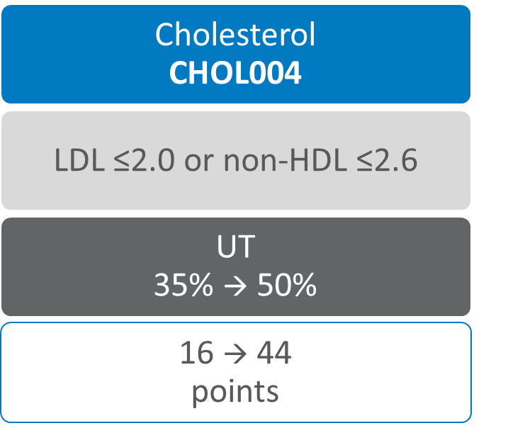
GP Contract 2025-26 Practice Manager’s Guide
QOF - Cholesterol
Cholesterol CHOL003
No change to thresholds
14 → 38
points
Prescribed
lipid lowering drug
UT = Upper Threshold
Notes:
Now I will hand over to Sarah for the next few slides
We have already covered the technical changes for CHOL003 which may make little real world impact to achievement even for 2024/25. The points value here has increased considerably.
The boundaries for points achievement remain at 70% for the lower threshold and 95% for the upper threshold.
First, remember that the indicator tests for an issue of a lipid lowering drug in the last 6 months, so reporting searches will be returning 0 until October. If you have How Am I Driving searches that usually look at the last 12 months these could show the real figure.
In the context of CHOL003 and CHOL004, it would make sense to tackle the patients who are not on lipid lowering therapy sooner rather than later. Once patients are on medication, your workload for ensuring that CHOL003 has a good achievement should be that much lower as in the second half of the year you should only need to focus on a smaller number of newly diagnosed patients plus those who have stopped their medication.
Think about what you have had to do during the 24/25 contract year.
Identify who declined a lipid lowering drug and follow them up this year
Remember to use Lipid lowering therapy declined rather than statin declined, so you only have to add 1 code rather than 6 (actually 5 given icospent ethyl has been dropped)

Slide 20
GP Contract 2025-26 Practice Manager’s Guide BP - Increased Threshold - More Points
Hypertension
HYP008
< 80
UT
77 → 85%
14 → 38
points
HYP009
≥ 80
UT
80 → 85%
5 → 14
points
STIA
STIA014
< 80
UT
73 → 90%
3 → 8
points
UT
86 → 90%
2 → 6
points
CHD
CHD015
< 80
UT
77 → 90%
12 → 33
points
CHD016
≥ 80
UT
86 → 90%
5 → 14
points
Diabetes
DM036
< 80
(without frailty)
UT
78 → 90%
10 → 27
points
STIA015
≥ 80
Notes:
The threshold changes are shown here on the screen.
For presenter info:
INDICATOR LT PTS INCREASE
HYP008 40 x2.7
HYP009 40 x2.8
STIA014 40 x2.66
STIA015 46 x3
CHD015 40 x2.75
CHD016 46 x2.8
DM036 38 x2.7
Highlight the change about DM036 now being under 80s. Leads to potential improvement / fewer PCAs needed for elderly patients who can’t be brought below target threshold.
Again, home BPs still have a lower target for all of these

Slide 21
GP Contract 2025-26 Practice Manager’s Guide QOF Changes - What does this mean for me?
If 10k patients:
0 extra patients
CHOL004
73 extra patients
worth extra £5,600
BP
7 indicators
224 extra patients
worth extra £17,800
CHOL003
worth extra £4,800
PATIENTS ON MULTIPLE INDICATORS WILL BE WORTH EVEN MORE MONEY THAN BEFORE!
NOT NEW MONEY!
Figures calculated on a list size of 10,000 with no adjustments for list size or prevalence and assuming £200 per QOF point

Slide 22
GP Contract 2025-26 Practice Manager’s Guide QOF Changes - What does this mean for me?
What if we don’t do the extra CHOL & BP work?
Total potential loss
£9,932
(10k list size)
Figures calculated on £200 per QOF point with no list size or prevalence adjustment
Notes:
If achieve the same % as the UT for 2024/25 these are the potential amounts the practice could lose (assuming £200 per point and no list size or prevalence adjustment); Basically around £1 per patient.
CHD015 - £1,716
CHD016 - £254.55
HYP008 – £1,351.11
HYP009 - £311.11
STIA014 - £544
STIA015 - £109.09
DM036 - £1,246.15
CHOL003 – 0 (UT remains the same)
CHOL004 - £4,400

Slide 23
GP Contract 2025-26 Practice Manager’s Guide
Other QOF Changes
Cholesterol medication updated in cholesterol and diabetes KPIs
Diabetes BP now for <80 only
No spirometry needed for asthma diagnosis
Asthma review – no longer need ACT or inhaler technique
PCA added for DOAC in AF (AF008)
Notes:
Big thing missing is concessions to childhood vaccinations targets
Indicators that were previously known as DM022/023 now accommodate alternative lipid lowering therapies that we know from CHOL003.
Concede that inhaler technique has never been a measurable requirement, despite being in the indicator description.
AF008 – invitation PCA

Slide 24
“GP Contract 2025-26 Practice Manager’s Guide
Reduced Admin”
No more reporting on
staff wellbeing meetings
IT system reviews
other non-clinical metrics

Slide 25
GP Contract 2025-26 Practice Manager’s Guide
Digital and Access Mandates
Financial Changes
QOF Reform and Reducing Admin
Digital and Access Mandates
PCN Changes - ARRS and CAIP
Enhanced Services and Incentives
Planning Ahead

Slide 26
GP Contract 2025-26 Practice Manager’s Guide
Digital and Access Mandates
Online GP appointment requests must be available during core hours from October 2025
GP Connect must be enabled to allow patient record sharing with NHS providers & private healthcare (with consent)
Community Pharmacy consultation summaries will be automatically sent into GP workflows
New "Patient Charter" will outline patient expectations & must be published on all practice websites
Notes:
From October 2025, practices must offer an online system where patients can:
Request a ‘non-urgent appointment’ for duration of core hours (“subject to necessary safeguards in place to avoid urgent clinical requests erroneously submitted online”)
Submit admin requests or medication queries for duration of core hours
Receive digital responses when appropriate
Online access must not replace traditional telephone and in-person booking but should work alongside them to reduce patient frustration – ‘equity of access’
GP Connect must be enabled including
Read-only access to patients’ care records by other NHS commissioned providers for the purpose of direct care (and private providers with explicit consent from patient)
Update record – allowing pharmacies to send consultation summaries into the GP practice workflow

Slide 27
GP Contract 2025-26 Practice Manager’s Guide
PCN Changes – ARRS and CAIP
Financial Changes
QOF Reform and Reducing Admin
Digital and Access Mandates
PCN Changes - ARRS and CAIP
Enhanced Services and Incentives
Planning Ahead
Notes:
Good news is that increased income seems to mainly be going into core funding.
Where QOF changes have happened either funding has gone into core or higher CVD targets
New CAIP - Continuity of Care funding available for high-risk patient management (via CAIP).

Slide 28
GP Contract 2025-26 Practice Manager’s Guide ARRS Workforce – Increased Flexibility
ARRS expanded to include GPs and Practice Nurses, with no recruitment caps
Salary reimbursement for ARRS-funded GPs increased to £82,418
Greater PCN autonomy in distributing workforce funding
Notes:
Still restrictions around GPs (must be within 2 years of qualification at point of recruitment and not previously held substantive GP role) and new Practice Nurse role (must not have been employed by the PCN or practices in the PCN in the last 12 months).
Mention of other restrictions being lifted BUT may need to wait for the fine-print on this!
GP ARRS money is no longer ringfenced and has been added to the main ARRS pot

Slide 29
GP Contract 2025-26 Practice Manager’s Guide New Capacity and Access Improvement Plan
£87.6mn PCN Capacity & Access Improvement Payment (CAIP) split into:
Population Health Risk Stratification to Improve Continuity of Care - £29.2mn
Modern General Practice access - £58.4mn
Notes:
Details unclear – all we have so far is “One domain will continue to focus on supporting modern general practice access (worth £58.4m) while the other (worth £29.2 million) will incentivise PCNs to use the intelligence gained from population health risk stratification tools to stratify their patients – including to identify those that would benefit most from continuity of care.”
So will have to wait and see what this means.
Might offer funding that can be used to support the new Digital Access contract requirements as this fits in the MGPAM??

Slide 30
GP Contract 2025-26 Practice Manager’s Guide
Enhanced Services and Incentives
Financial Changes
QOF Reform and Reducing Admin
Digital and Access Mandates
PCN Changes – ARRS and CAIP
Enhanced Services and Incentives
Planning Ahead
Notes:
Good news is that increased income seems to mainly be going into core funding.
Where QOF changes have happened either funding has gone into core or higher CVD targets
New CAIP - Continuity of Care funding available for high-risk patient management (via CAIP).

Slide 31
GP Contract 2025-26 Practice Manager’s Guide
Advice and Guidance LES
£80m for A&G
£20 per referral
£80mn guaranteed for Primary Care
Local commissioners can decide on action once funding used
Notes:
About £1.25 per patient for funding
Practices will have the opportunity to take part in a new enhanced service worth up to £80 million for advice and guidance (which will begin in April 2025). This funding is in addition to the increase of £889 million across the core practice contract and the Network Contract DES.
The enhanced service will incentivise even closer working between general practice and secondary care and support the government’s commitment to move more care from secondary care into community settings. It will help to ensure that patients receive care in the right place at the right time via the use of specialist advice and guidance, whilst also supporting elective recovery.
Practices will be able to claim (subject to eligibility criteria set out in the enhanced service specification) a £20 Item of Service (IoS) for pre-referral requests.
Worth considering areas to target for A&G and we’ll be producing some resources to help with this soon

Slide 32
GP Contract 2025-26 Practice Manager’s Guide
Weight Management LES
£11.50 per referral to Weight Management Services
Notes:
No changes from last year

Slide 33
GP Contract 2025-26 Practice Manager’s Guide
Planning Ahead
Financial changes
QOF reform & Reducing admin
Digital and access mandates
ARRS changes
Enhanced services and incentives
Planning Ahead
Notes:
Good news is that increased income seems to mainly be going into core funding.
Where QOF changes have happened either funding has gone into core or higher CVD targets
New CAIP - Continuity of Care funding available for high-risk patient management (via CAIP).

Slide 34
GP Contract 2025-26 Practice Managers Guide Key Deadlines & Compliance Requirements
April 2025
October 2025
New GP contract changes come into effect
Online GP appointment requests must be available during core hours
Practices must align with new QOF and Enhanced Services requirements

Slide 35
GP Contract 2025-26 Practice Managers Guide
Changes to Childhood Vaccination Schedule
From | Changes
1st Jul 2025 | Changes to Hib/MenC vaccinations
1st Jan 2026 | Introduction of new 18 month visit gradually replacing the 3 years 4 month visit
 | Introduction of new MMRV vaccine (subject to final policy decision)
See Annex E of the “Changes to GP Contract in 2025/26” letter for full details
Notes:
Significant changes to the Childhood Vaccination schedule will start from beginning of July although the main impact of changes will be from 1st Jan 2026
With the gradual change from the ‘preschool booster’ at 3 years 4 months to the new 18 month visit there will be an increased vaccination workload between 1st Jan and 31st Oct 2026
June/July – Hib/MenC won’t be offered to children born after 01/07/2024 when they turn 1. Children born before this will still be subject to that schedule so Practices need to continue ordering it until national stock runs out.
From January 2026 there may be an increase in the number of patients needing vaccination appointments as some childhood doses start to be brought forward.

Slide 36
GP Contract 2025-26 Practice Manager Guide
Planning Ahead
April 2025
Digital Transition planning – deciding model and plans
June/July 2025
September 2025
Posters/SMS/social media information on Digital Access
Inform patients about practice plans for continuity of care via website, SMS, posters, and social media
Plan staff training re Digital Transition
October 2025
Contractual changes to access from 1st October
Nov/Dec 2025
Prepare for new childhood vaccination schedule starting 1st Jan 2026
Changes to GP Connect must be enabled by 1st October at latest
Agree PCN approach to CAIP – access & continuity of care
QOF planning
Publish patient charter on website (once available)
Staff training on changes to childhood vaccination schedule (once training available)
Update practice materials ready for Digital Transition/changes
Consider ARRS changes as a PCN
Ensure full utilisation of ARRS funding before end of Q4
ARRS workforce expansion plans in place

Slide 37

Questions?

