Slide 1

Darlington PCN COVID 19 SOP
UPDATED
20/3/2020

Slide 2

Contents
Standardising the message
Managing the phone
Symptomatic patients that need seeing
Walk ins
PPE
Cleaning
Home visits
Care homes
Prescriptions
Those with communication difficulties (language/deafness for example)
Consumables
Staff
Telephone consultations
F2F consultations
Outside agencies
111 appointments
Routine work
Vulnerable patients
Death
HPA
CDDFT update
Community response
Resources
Summary of clinical evidence. *every clinician should read*

Slide 3
Standardising the Message
Statement for websites
PCN social media.
Standard text messages to patients
Phone message
Posters
Information slips for reception.

Slide 4
Website Message
As per government guidance we will be moving to a telephone triage service from Monday (16th).
You may find it more convenient to submit an E-consult via our website ………………….. You will receive a response from a clinician within 48 hours.
If your problem is more urgent please contact the surgery and a telephone triage appointment will be arranged. If the clinician feels you need to be seen, please be reassured that a face to face appointment will be made.
If you have a NEW persistent cough or a high temperature above 37.8C and are worried you may have coronavirus you need to follow these guidelines
  If you live alone you should stay at home (self-isolate) for 7 days from the onset of symptoms following the current advice.
  If you live with others then you must stay at home for 7 days, but all other household members who remain well must stay at home and not leave the house for 14 days
  After 7 days of self-isolation, people who feel better and no longer have a high temperature can return to their normal routine
  If they have serious symptoms that they cannot manage or have no signs of improvement after 7 days they should use NHS111
If your symptoms worsen please see NHS website for more information www.nhs.co.uk/coronavirus or call 111
If you require a sick note please go to www.111.nhs.uk/isolation-note/
Sorry for any inconvenience and thank you for understanding.

Slide 5

Phone Message
As per government guidance we will be moving to a telephone triage service from Monday (16th).
You may find it more convenient to submit an E-consult via our website ………………….. You will receive a response from a clinician within 48 hours.
If your problem is more urgent please contact wait for a receptionist and a telephone triage appointment will be arranged. If the clinician feels you need to be seen, please be reassured that a face to face appointment will be made.
If you have a NEW persistent cough or a high temperature above 37.8C and are worried you may have coronavirus you need to follow these guidelines
  If you live alone you should stay at home (self-isolate) for 7 days from the onset of symptoms following the current advice.
  If you live with others then you must stay at home for 7 days, but all other household members who remain well must stay at home and not leave the house for 14 days
  After 7 days of self-isolation, people who feel better and no longer have a high temperature can return to their normal routine
  If they have serious symptoms that they cannot manage or have no signs of improvement after 7 days they should use NHS111
If you are ringing for a sick note please go to www.111.nhs.uk/isolation-note/ where you can complete a short statement and if appropriate a sick note will be produced
Sorry for any inconvenience and thank you for understanding.

Slide 6

TEXT
As per government guidance we will be moving to a telephone triage service. E-Consults can be submitted via our website…… alternatively you can book a telephone appointment where a clinician will decide if you need to be seen.
If you have a NEW persistent cough or a high temperature above 37.8C and are worried you may have coronavirus you need to follow these guidelines
  If you live alone Self isolate for 7 days from the onset of symptoms.
  If you live with others and they remain well the must self isolate for 14 days

Slide 7
Managing the phone
Phone to be answered as a high priority.
Hello you are through to *Practice Name*, *receptionist name* speaking, how can I help you?
Visit request
Appointment request
Medication request
Advice request
Sick note request
Request added to visit list *for telephone triage*
Ensure patient aware they will receive a call and document the most appropriate number to call them on.
Home visit guidance has been circulated
Advise the patient to submit an online consultation via the practice website where possible.
Where this is not appropriate book a telephone call with the most appropriate clinician. Ensure that you document a correct telephone number and advise the patient that if the call is urgent they will get a call on the same day, but that you cannot guarantee what time the telephone call will be. If a routine call is appropriate book into a routine telephone appointment slot.
Do they have a cough or fever? Advice them to self isolate for 7 days and for their household members who have no symptoms to isolate for 14 days. If needs assessment book telephone appt with GP.
Advise the patient to make the requests Via system online or the NHS App. If this is not possible please advise them to write their request and post through the practice post box. Ensure the appropriate chemist is identified as ALL prescriptions will be sent ETP where possible.
Please signpost patients who are insolation to the following link for sick notes
https://111.nhs.uk/isolation-note/
Can text links, email or get off website
If no cough or fever- Advise them to submit an online consultation via the practice website. If this is not possible offer them a telephone call with the most appropriate clinician. Ensure that you document a correct telephone number and advise the patient that if the call is urgent they will get a call on the same day, but that you cannot guarantee what time the telephone call will be. If a routine call is appropriate book into a routine telephone appointment slot.

Slide 8

Symptomatic Patients That Need Seeing
If a patient is symptomatic of COVID 19, but need to be assessed in primary care this needs to be organised. As of Monday 21st March patient will be directed to the Hot Site which is at PHD.
Rotas have been provided to Practice Managers
There will be 1x GP and 1x NP working 10-4pm initially (this will be reviewed as things develop).
Processes circulated
PPE must be used – We are asking all surgeries to help keep the Hot Site stocked up
    Glasses, mask, apron, gloves. Where possible scrubs to be worn/clothes changed before leaving the surgery.
    Patients to wear face mask.
  Avoid running any other clinics at the same time
  Ensure full decontamination procedure at the end of the clinic.
Ahmet Fuat leading on clinical assessment- more to follow.

Slide 9
Walk ins
Set up a screening area at the front door.
Provide any ‘screeners’ with PPE
  Gloves, apron and face mask
Ensure posters clearly displayed stating what to do if patients have symptoms.
Hand out a slip that summarises how to access primary care services.
Ensure leaflets are available in common languages.
If patient is too unwell to go home and await telephone triage OR if a communication barrier makes this difficult- place in the isolation room. Clinician to assess wearing PPE.

Slide 10
PPE
Scrubs, Mask, apron, gloves. Glasses if coming into close contact (eg examination)
Follow donning and doffing procedures
FP3 required if throat examination needed. These have been ordered but are not yet available.
Not needed for contact with non-symtpomatic patients.
Scrubs should be changed into on arrival to work and before leaving.
If manning the hot clinic scrubs should be removed before leaving the consultation room.

Slide 11
Cleaning
Ensure all clinical rooms are thoroughly cleaned after each session.
Each employee is responsible for cleaning their own workspace with alcohol wipes at least twice a day. This includes telephones and keyboards. Work spaces to be cleaned if users change.
Patient facing reception area to be cleaned with antiseptic hourly. Create a staff rota. Consider door handles, self check in screens, seats etc.
Staff communal areas to be cleaned twice daily.
Remove all magazines, toys and leaflets.
Ensure guidance for decontamination is followed if a room has been used by someone suspected of having coronavirus.
Sue Dixon leading- more to follow.

Slide 12
Home visits
All home visits to be triaged
Use video consultation where possible.
PPE to be worn for all home visits.
  Apron, gloves, mask
  Ensure clinical waste bags in vehicle to place PPE inside.
Hand washing before and after each visit.
Minimise the number of clinicians doing visits.
PCN visiting service being developed.

Slide 13
Care Homes
MDTs suspended. Tuesday-Friday there will be a GP available to give advice to the matrons- telephone and video consultations and video MDTs as needed. Ability to visit wearing PPE as needed. Working up SOP and links with palliative care team
Requesting care homes make prescription requests/queries electronically
Matrons ensuring all DNR and EHCPs are up to date.
If the care home MDT GP is not available matrons will be given bypass numbers for each practice. If less urgent an urgent task to reception (which will include their mobile number) will be sent.
All visits to care homes to have been discussed with community matron by care home before GP requested
Use video consults where possible.
PPE to be worn
Hand washing before entering the care home and before & after examining the patient

Slide 14
Prescriptions
Requests online via NHS App or SystmOnline where possible
Your surgery may accept Emails/econsult with patient DOB and name and prescription request info on.
Written requests to be posted. Where possible ensure there is a secure post box accessible from outside the building.
All prescriptions to be sent ETP
Do not issue inhalers or rescue packs just in case (See email from Claire Adams)
Do not change the issue duration for longer- max 56 days, but should remain on 28 if that is what they previously had.
Do not prescribe paracetamol unless had on repeat previously.
Use electronic repeat dispensing where possible- give 6 months.

Slide 15
Those with Communication Difficulties
Ensure they can access triage via a screening area at the front door.
Ensure that leaflets are available in common languages.
If telephone triage is not possible (language barrier or deafness, no access to telephone) advise the patient to sit in the isolation room. A clinician will see them in there using PPE.

Slide 16
Consumables
Keep tight stock control
Share with Janet Robson if you are struggling to get anything.

Slide 17

Staff
Sickness process – this has been discussed and agreed with all practices. PM’s have all relevant information. A town wide agreement was made. Will be reviewed alongside of government changes
Welfare
  We need to plan how we are going to look after each other
  Arcus counselling available to all staff
  GP choices
  Ensure regular breaks and cycling staff in and out of most intense work.
Attendance
  Workforce plan being developed and will be a priority to complete this week to enable us to support each other.
  A template letter has been provided to PM’s for key workers to produce to school – please not the council have confirmed it is our choice to identify the key workers not the school
Infection control
  Ensure all staff aware of policies- ensure policies contain information relevant to Covid19. We have developed a policy for the hot clinic which can be shared.
Critical people
  Start sharing skills and information
  Eg log in details / bank details

Slide 18

Staff Resources
Staff Risk assessment
  Part 1
  Part 2
Key worker letter
Self isolation: https://assets.publishing.service.gov.uk/government/uploads/system/uploads/attachment_data/file/874011/Stay_at_home_guidance_diagram.pdf

Slide 19
Remote Consultations
Use AccuRx for video consultations (not endorsed by our CCG but it is by others) AM-J is working on a ‘how to’ guide.
PCN has purchased Zoom for video conferencing. Contact darlington.pcn@nhs.net for access.
Jehanne is leading on improving remote working capabilities where possible
Janet is purchasing mobile phones for each practice. (ensure these are regularly cleaned)
Document that telephone triage taken place during COVID19 Pandemic. Consider creating an auto-consult for this
Review telephone triage/consultation training.
  egplearning.co.uk/quick-telephone-consultation-tips-for-primary-care/
Patrick Holmes leading- more to follow

Slide 20
Face to Face Consultations- non symptomatic/self isolating
Clinician to ensure patient uses alcohol gel on their hands before entering the room.
At the end of the consultation clinician to wash hands and ensure all equipment is wiped down with an alcohol wipe.
At the end of each session clinical room to be cleaned.
Ensure disposable equipment is used where possible (e.g Tourniquets) PHD will be trying to purchase disposable tourniquets for all practices.
Ensure consulting and waiting rooms are well ventilated- open windows
DO NOT EXAMINE ANY THROAT or NOSE WITHOUT AN FP3 MASK!!!

Slide 21
Outside Agencies
Ensure all outside agencies who use your premises are screening their patients on the same day to ensure they are not symptomatic with a persistent cough or fever >37.8degC.
Limit where possible the amount of outside agencies coming on the premises- but some clinics must continue e.g INR

Slide 22
111 Appointments
Clinician to triage all 111 appointments to ensure the patient needs seeing face to face and does not have a cough or fever.
PHD have contacted 111 to advise them not to tell patients to come to the surgery, but wait for a call.
Any issues please raise with PHD.

Slide 23
Routine Work
Agreed
Contraception – telephone, 3 month supply of pill, depo’s to still be done
Vaccinations – continue
Dressings – continue – review frequency
Injections – necessary only
Bloods/monitoring – Clinicians decision
Chronic disease- those who are unstable will be seen
Medicines management – phone call
PHD clinics continue for coils and implants

Slide 24

Vulnerable patients
Group 1
We took the following steps when drawing up the list of patients who can be identified centrally by extracting relevant groups from national datasets:
a) NHS England Clinical Reference Groups (groups of experts who advise the NHS on Direct Commissioning) were asked to consider which conditions would put patients at intermediate, high or very high risk of severe morbidity or mortality from COVID-19
b) Based on our current understanding and specialist and wider advice senior clinicians (NHSE, NHS Digital, PHE, CMO, DCMOs) categorised these conditions into the following high risk groups (see below)
1. Solid organ transplant recipients
2. People with specific cancers
• People with cancer who are undergoing active chemotherapy or radical radiotherapy for lung cancer
• People with cancers of the blood or bone marrow such as leukaemia, lymphoma or myeloma who are at any stage of treatment
• People having immunotherapy or other continuing antibody treatments for cancer
• People having other targeted cancer treatments which can affect the immune system, such as protein kinase inhibitors or PARP inhibitors.
• People who have had bone marrow or stem cell transplants in the last 6 months, or who are still taking immunosuppression drugs.
3. People with severe respiratory conditions including all cystic fibrosis, severe asthma and severe COPD
4. People with rare diseases and inborn errors of metabolism that significantly increase the risk of infections (such as SCID, homozygous sickle cell disease)
5. People on immunosuppression therapies sufficient to significantly increase risk of infection
6. People who are pregnant with significant heart disease, congenital or acquired
Group 2
There are some patients on this list who will be contacted by other routes due to limitations in national datasets. For example, Cancer Units will contact all patients in category 2; secondary care will contact most of the patients in category 5 via a cascade from the Royal College of Physicians and associated medical societies
Group 3
In addition, the Academy of Medical Royal Colleges will ask its members to identify any other subgroups of patients they feel are at high risk, and will cascade templates to hospital specialists. We will ask clinicians who have identified these patients to let them know directly using a standard letter containing the information they need to commence shielding and access support. We will ask hospital specialists to inform the GP of the decision to include patients in the vulnerable group.
Group 4
In addition, we will issue GPs with specific guidance around identification of high risk patients with complex / severe multimorbidity and ask the GP to contact these groups directly to recommend they are considered for inclusion in the shielding group.
We accept that given this is a new and rapidly moving disease there are inevitable limitations in our methodology but have designed the most robust approach that was possible at pace with the aim of identifying the maximum number of vulnerable individuals in sufficient time to effectively shield this group.
Further detail about what GPs should do in this letter:

Slide 25
Death
Information on certification and cremation forms coming soon. Nicky Cooling will lead/share.
Palliative care teams setting up advice lines
Information on advanced care planning and mortality predictors:

Slide 26
HPA
The local PHE Health Protection Team should be informed of cases or situations relating to contextual settings:
  any case from a longterm care facility
  any case from a prison or prescribed place of detention
  any outbreak in a hospital or healthcare setting
  schools
  other unusual scenarios

Slide 27
CDDFT update
No longer accepting routine referrals
resp and non resp streams for urgent care and A+E
Urgent care should now be telephone triaging.
Looking to create a low risk site for urgent and cancer work.
Clinical advice line is still open and planning to extend to other services such as haematology and oncology but likely to stop in respiratory
DNs triaging all routine work.
Open access radiology- if urgent x ray required in any self isolating individual call speciality consultant or Respiratory ED stream to discuss.

Slide 28
CDDFT update
Urgent care WILL need more support and staff. Rotas to come out. Please consider helping.
Community Hospitals WILL need more support and staff. Rotas to come out. Please consider helping.
Request to support Richardson hospital with medical cover also- more detail to come
Working on ‘virtual ward’ for those with significant need but not suitable for hospital.
  Rockwood 5+ critical -care not appropriate- kept at home where possible.
  All others in ‘red’ zone to be discussed with hospital to agree plan
  Senior physician available 18hrs a day for case discussion if needed
  All admissions to go via ED with early senior assessment and decision making
  All discharges for COVID 19 suspicious symptoms will have advance care planning will be completed.
  GP needed in DN huddle each day to review highest risk.

Slide 29
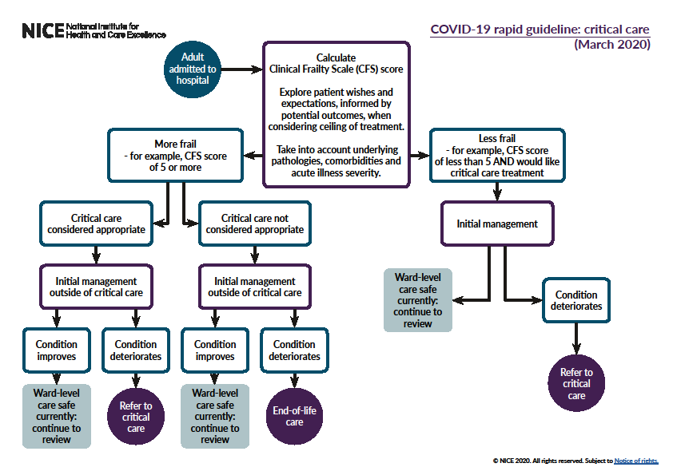


Slide 30
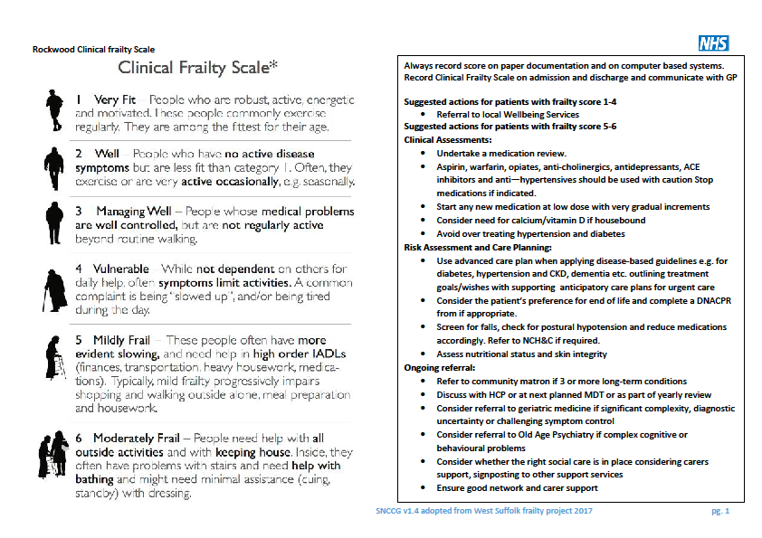

Slide 31
Community response
From Tuesday there will be a single telephone line that will be the ‘hub’ for vulnerable people
Working with system partners and voluntary sector
WBF will be working in this hub.
Please start identifying vulnerable patients- look at frailty and housebound lists (HCAs can do)

Slide 32
Draft Covid-19 Clinical Assessment Pathway
Adapted for Darlington PCN by Professor Ahmet Fuat and Dr Patrick Holmes
with gratitude to
Dr Matthew Knight, Consultant Respiratory Physician West Herts Hospital Trust
Dr Daniel Carlton-Conway, Board Member, Clinical Lead Primary Care, Herts Valleys CCG

Slide 33
Covid-19 Management Pathway
Primary Care Assessment
Virtualise wherever possible (telephone/video/observation stations)
Minimise contact wherever possible
Observations hubs will allow observations to be done (oxygen saturations, respiratory rate, heart rate) and virtual follow up for decision making
Face to face hubs will allow for enhanced assessments depending on need

Slide 34
Be alert to non-Covid19 presentations of severe illness
Primary Care Assessment of ADULTS with
Covid-19 Related Symptoms
(Virtual Consultation - Video if possible)
ALWAYS USE CLINICAL JUDGEMENT TO SUPPLEMENT PATHWAY – CLINICAL JUDGEMENT OVER-RIDES PATHWAY
Green
No significant dyspnoea
No Wheeze
Mild symptoms apart from fever >37.8c
Symptoms not significantly deteriorating
Amber
Mild to moderate chest tightness/wheeze
Breathless on 1 flight of stairs or <50metres
Faint/dizzy
Significant headache
Significant reduction in fluid intake
Other clinical concerns
Red
Severe shortness of breath or wheeze
Severe chest pains
Extreme faintness or collapse
Signs of sepsis
Cardiac sounding symptoms
No
Needs Further Assessment?
Assessment Options
Observations
Clinic
Home Visit
If appropriate Emergency Hospital Assessment via ED
Yes
Higher Risk Age & Comorbidities?
Age>50
Comorbidities
eg Diabetes/HTN
Cancer/COPD
Other significant disease
Other clinical concerns
Acceptable Assessment
Sats > 94%
HR<100
RR <20
No other significant red flags
Intermediate Assessment
Sats 92-94%
RR>20
HR>100
Deteriorating symptoms
Clinician concerned
Red Flag Assessment
Sats <92%
Severe breathlessness
Signs of sepsis
Other emergency signs
No
No
Yes
COMMUNITY COVID FOLLOW UP PATHWAY
Safety Net
Telephone/Text Message contact at day 7 and day 10
Self Manage and Safety Net
Clinician concerned patient needs hospital assessment
Yes
Discuss with acute medic on call

Slide 35
Telephone Assessment
Incubation period average 4/7(Inter-quartile range 2-7/7), possibly up to 14/7
Common initial symptoms of those hospitalized
  Fever (77-98%)
  cough (46-82%)
  myalgia/fatigue (11-52%)
  Shortness of breath (3-31%)
Less common symptoms include nausea, diarrhea, headache, sore throat, abdominal pain dizziness and new onset anosmia
Remember some patients appear to have a very mild/asymptomatic clinic course

Slide 36
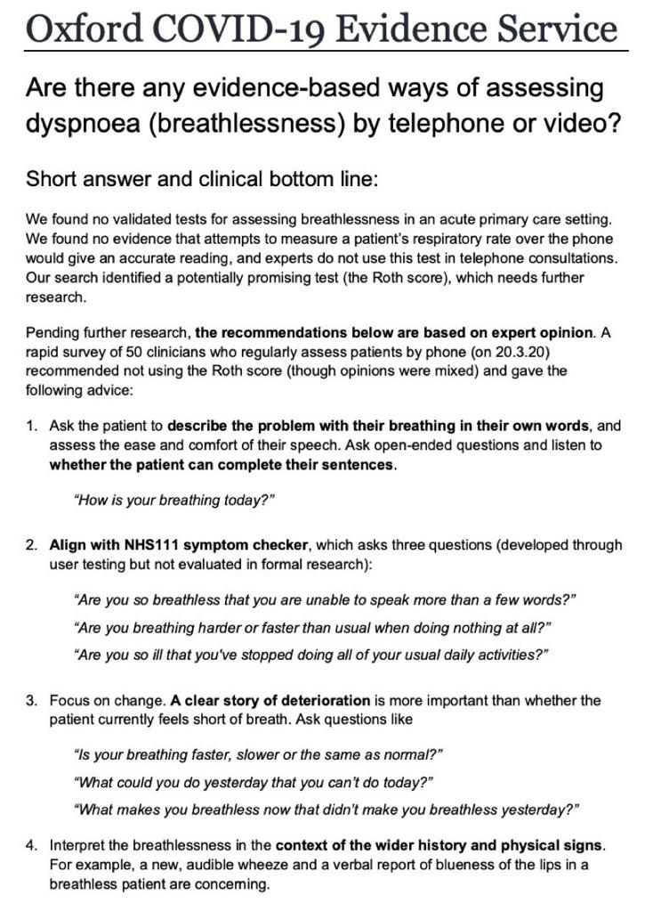

Slide 37

Roth Score
This test was designed
to remotely assess
someone's level of
oxygenation
without using a pulse
oximeter.
Ask the patient to count in
their native tongue in one
breath from 1 to 30.
If this takes longer than 8
seconds if is 78% sensitive and
71% specific for a pulse oximeter
<95%, and worthy of considering
further assessment.

Slide 38
Resources
Main advice for GPs on the NHS website: https://www.england.nhs.uk/coronavirus/primary-care/
The key page from NHS England, with all the resources:
https://www.england.nhs.uk/coronavirus/primary-care/
https://www.england.nhs.uk/wp-content/uploads/2020/02/20200305-COVID-19PRIMARY-CARE-SOP-GP-PUBLICATION-V1.1.pdf
https://www.gov.uk/government/publications/wn-cov-guidance-forprimary-care/wn-cov-interim-guidance-for-primary-care
The RCGP COVID-19 page can be found here, and includes prompt sheets for receptionists, and a leaflet for patients in isolation within the surgery: https://www.rcgp.org.uk/policy/rcgp-policy-areas/covid-19-coronavirus.aspx
https://campaignresources.phe.gov.uk/resources
https://campaignresources.phe.gov.uk/resources/campaigns/101-coronavirus
https://www.nhs.uk/conditions/coronavirus-covid-19/
The coronavirus symptom checker is available at: https://111.nhs.uk/covid-19
www.primarycarepathways.co.uk/covid2019
Podcast on digital technology to help with COVID 19 pandemic in primary care: https://www.youtube.com/watch?v=cZz40OY58gM

Slide 39
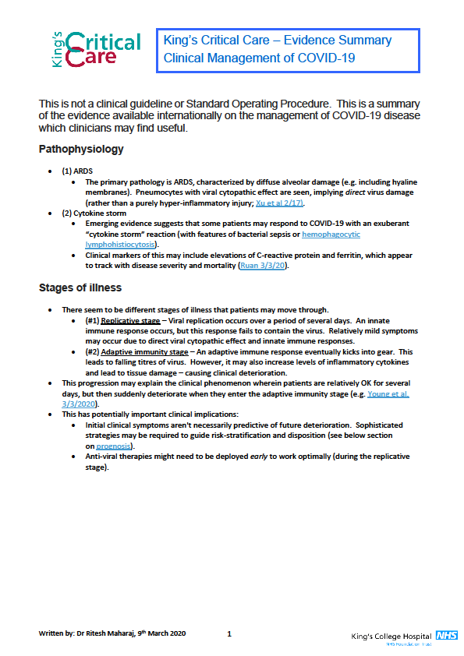
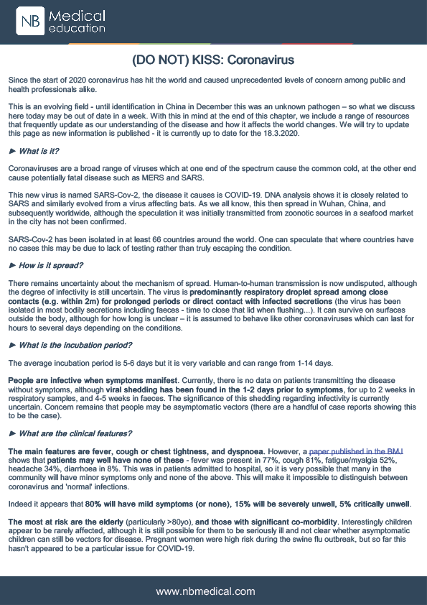
Helpful Summary of Clinical Evidence
(double click)

Slide 40
Clinical Leads
Please direct any specific questions to the appropriate clinical lead:
PPE- Angus Ross
Clinical telephone triage for COVID 19- Patrick Holmes
Clinical assessment and management of COVID 19 in 1ry Care- Ahmet Fuat
Death Certification and cremation forms- Nicky Cooling
Children’s mental health during isolation- Sally Stone
Centralising all workload and video consultations- Alison MacNaughton-Jones
Overall co-ordination- Amanda Riley
Practice nurse liaison with DNs- Holly Phillips
Care Homes- Hassan Tahir.

